Slide 1
Capstone Project – 1 EDA Play Store App Review Analysis
Rupesh Tomar

Slide 2
DISCUSSION OF GOOGLE PLAY STORE DATASET WILL INVOLVE VARIOUS STEPS SUCH AS: -> Introduction -> Problem Statement -> Goal of the Project -> Introduction to Data -> Data Summary -> Data Pipelining -> Exploratory analysis and visualizations -> Analysis Summary -> conclusion -> Challenges -> Q & A

Slide 3


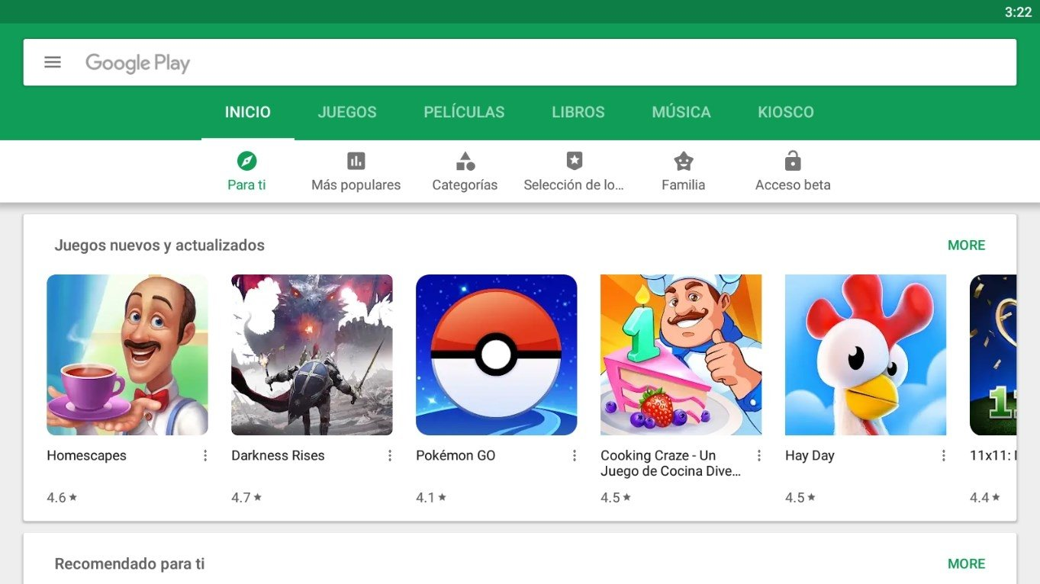
INTRODUCTION:-
Android is the most popular operating system in the world, with over 2.5 billion active users spanning over 190 countries.
Google Play was launched on March 6, 2012, bringing together Android Market marking a shift in Google's digital distribution strategy .
Android is the dominant mobile operating system today more than 85% of all mobile devices running Google’s OS. The Google Play Store is the largest and most popular Android app store.
There are more than 3.04 million apps found on Google Play Store.

Slide 4

PROBLEM STATEMENT:-
The Play Store apps data has enormous potential to drive app-making businesses to success.
Actionable insights can be drawn for developers to work on and capture the Android market.
Each App Containing values of the category, rating, size and much more.
Another dataset contains customer reviews of the android apps.
In user has given reviews which are measured in positive, negative, or neutral sentiment.
The purpose of our project is to gather and analyze detailed information on apps in the Google Play Store in order to provide insights on app features and the current state of the Android app market.
The Objective of the project to Explore and analyze the data to discover key factors responsible for app engagement and success.

Slide 5
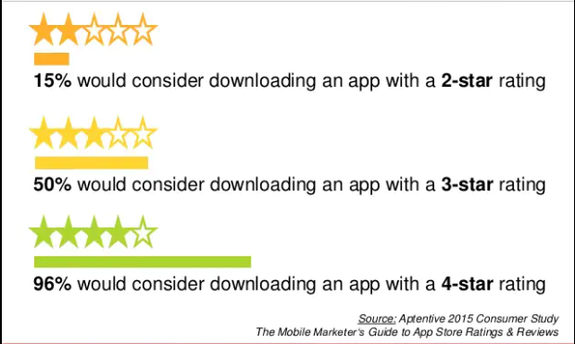
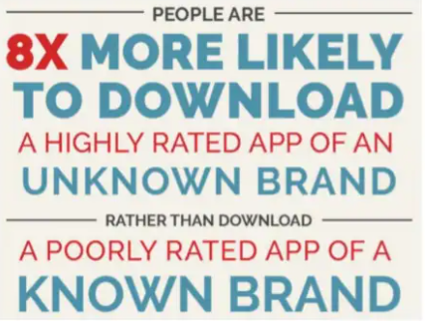
GOAL OF THE PROJECT With around three million apps available on Google Play Store, developing apps that stand out amongst the competition poses a challenge for app developers. To differentiate themselves in this oversaturated market, they need to pinpoint essential factors that play a role in customers’ decision-making process. The objective of this project is to deliver insights to understand customer demands better and thus help developers to popularize the product. To clarify, the ‘popular’ in this project means a high number of installations.

Slide 6
INTRODUCTION TO DATA Firstly let's get to know data. While we were analyzing the data, we used Pandas library. -> info(): It informs about data columns and data types. -> head(): It returns the first five data. -> tail(): It returns the last five data. -> columns : It returns data columns -> shape : It gives number of rows and columns in a tuple.

Slide 7
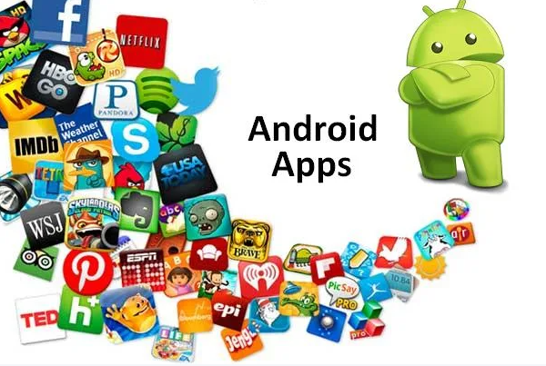
DATA SUMMARY The dataset contains details of Android applications present on Google Play Store. For analysis of the mentioned data we have used Python. Our business case is to locate the best Apps, which we measure by Review check. There are 13 includes that depict each application and an aggregate of 10841 applications. Following variables were initially included: 1. App – Name of the app 2. Category – Category of the app 3. Rating - Over all user rating of the app out of 5 on the Play Store 4. Size – Size of app 5. Reviews – Number of user reviews for the app 6. Installs – Number of user downloads/installs for the app 7. Type – Paid or free 8. Price – Cost of the app 9. Content Rating – Age group the app is targeted at 10. Genres - An app can belong to multiple genres (apart from its main category) 11. Last Updated - Date when the app was last updated on Play Store 12. Current Ver. - Current version of the app available on Play Store 13. Android Ver. – Minimum required android version

Slide 8
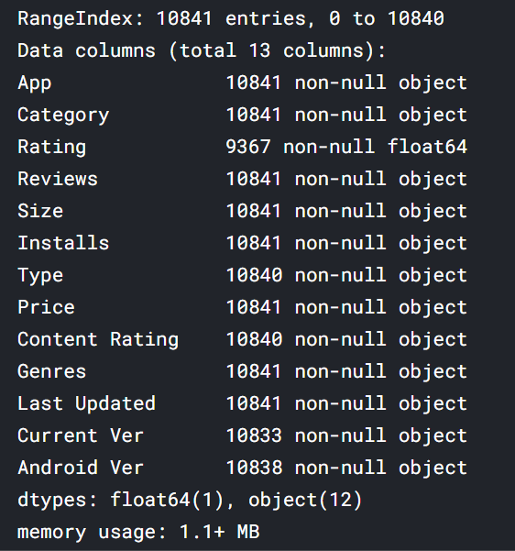
DATA PIPELINE 1. DATA PREPARATION It has information such as app name, category, rating, and more. And the other is a list of reviews for each app with the sentiment if that particular content of the review was positive, neutral, or negative. Data preparation is the process of cleaning and transforming raw data prior to processing and analysis. It is an important step prior to processing and often involves reformatting data, making corrections to data and the combining of data sets to enrich data. 2. GATHERING DATA This step is about getting to know the data and understanding what has to be done before the data becomes useful in a particular context. This can be done by reading the CSV file and doing initial statistical analysis. Though the dataset may seem to have the correct data types for each column, we need to check it. Inconsistent data types will create issues while dealing with problems.

Slide 9
DATA PIPELINE(Contd…) 3. DATA CLEANING: First, we have analyzed which information column is irrelevant to the number of installs of the app. It was done by common sense. We removed size, last updated date, current version, and android version because they are not the factor that would affect the number of installs before publishing. Also, we have removed the rating and number of reviews because they are obviously associated with app installs and would not be known before publishing. Then we also trimmed our data of any out-of-place characters. 4. DATA VISUALIZATION: This can be used to get a glimpse of the distribution of the app market. This can help businesses in several ways. Apps could be targeted to a particular market. A business could analyze its approach to entering a market with more/moderate/fewer competitors. If the app holds a feature that may change the future usage of users, a data-driven business venture could launch the app in the market of more competitors to get a better hold of the market relying on that key feature and making further development.

Slide 10
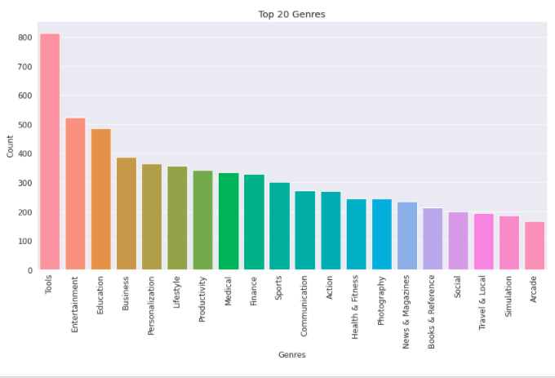
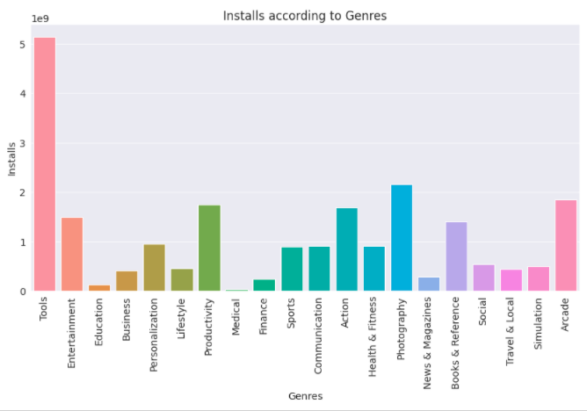
EDA ->Top 20 apps present in the ->Genres that are getting installed Google play store as per their Genres. most in top 20 Genres.

Slide 11
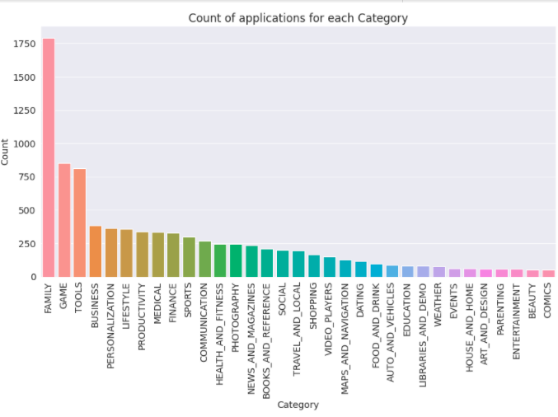
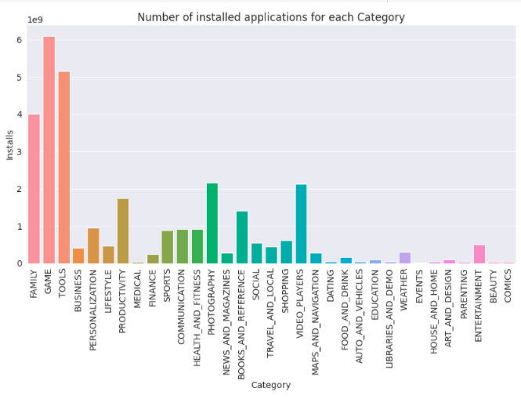
EDA(Contd…) -> Top 20 Categories: ->Top 20 applications based on category
Most of the apps in Play Store belongs to the category of 'Family'.
And then 'Game' and 'Tools'.

Slide 12
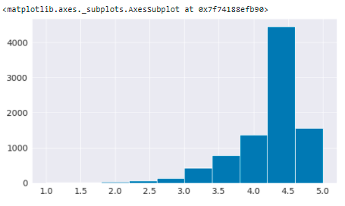
EDA(Contd…) -> average Rating of apps on play store -> According to the graph the average rating of apps on play store is 4.18

Slide 13
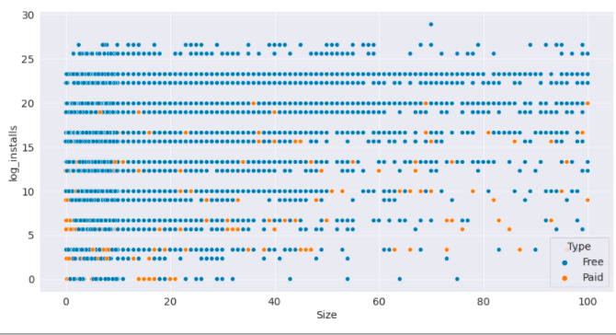
EDA(Contd…) Q. How does size impact on the number of installs of any application? -> Size of the applications present in the dataset are in MB and KB. It is clear from the above mentioned plot that size may impact the number of installations. Bulky applications are less installed by the user and this applies for both type of apps paid and free.

Slide 14
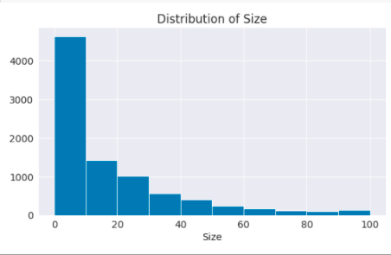
EDA(Contd…) -> size of apps: -> From the histogram, it can be concluded that maximum number of applications present in the dataset are of small size. 0 to 10 MB.

Slide 15
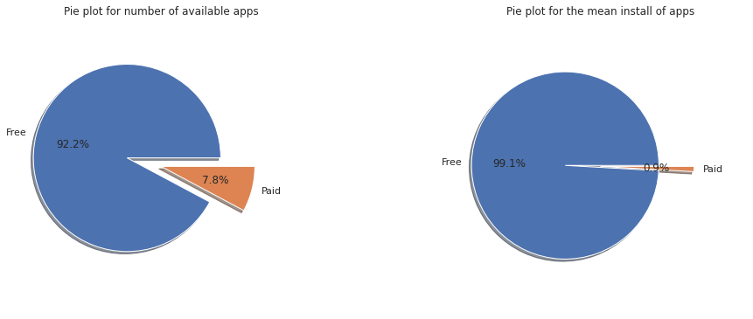
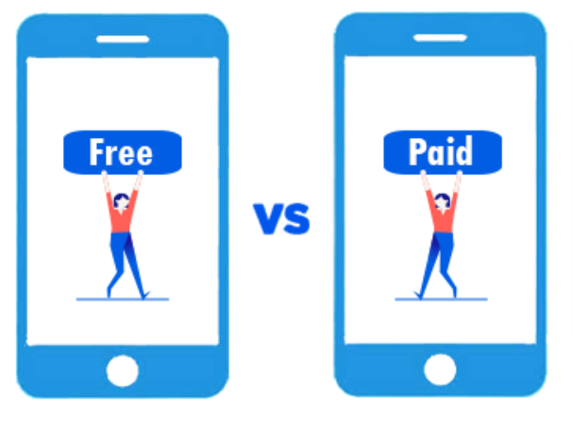
Paid app vs Free app
EDA(Contd…)
The number of paid apps is 7.8 percent of the total available apps.
The average install of paid apps is 0.9 percent of the average install of all apps.
Since the percentage of available free apps is lesser than the percentage of average install of free apps therefore the free apps are in more demand as compared to paid apps.

Slide 16
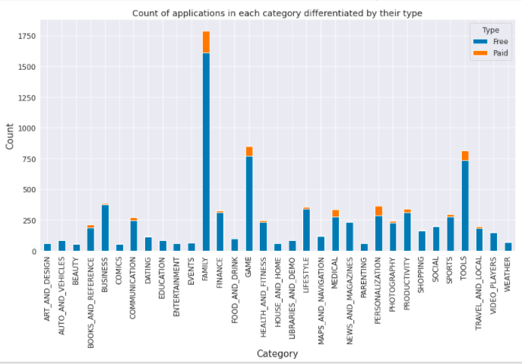
EDA(Contd…) -> The count of applications in each category differentiated by their type: -> Top 3 category of paid apps and free apps are same Family, Tools and game.

Slide 17
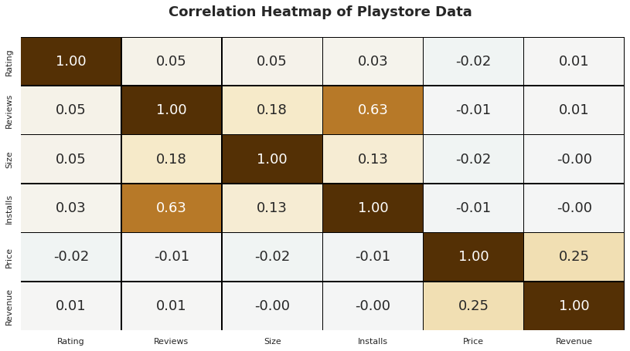
Correlation between various parameters.
EDA(Contd…)
The Reviews and Installs columns have a strong positive correlation. This shows that higher the install the higher will be the reviews.
Price is slightly inversely connected to Rating, Reviews, and Installs. This means that as the app's price rises, the average rating, total number of reviews, and Installs decrease significantly.
The Rating column has a minor positive correlation with the Installs and Reviews columns. This suggests that as the average user rating rises, so will the number of app installs and reviews.

Slide 18
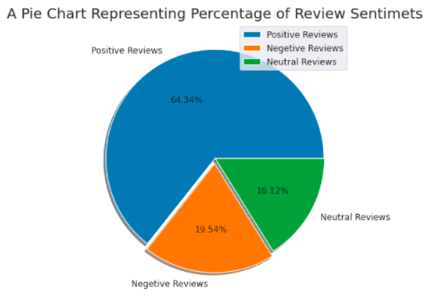
EDA(Contd…) -> Overall users review Sentiments are 64% Positive 20% Negative and 16% Neutral.

Slide 19
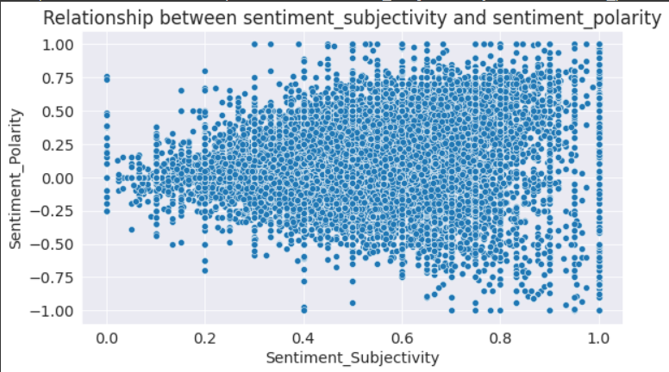
IMPORTANT FINDINGS:-
Sentiment subjectivity is not always proportional to sentiment polarity.
But in maximum number of cases, it shows a proportional behaviour when variance is too high or low.

Slide 20
Conclusion ❖ The majority of users prefer free apps. The size of the app does not directly affect their decision to use paid or free apps. ❖ The highest number of apps have been published in the Family, Games, and Tools categories on the Play store, but the highest number of installations have come from the Games category. ❖ The apps which have the ratings above 4, are actually targeting all the people and not a certain age group. ❖ Dating, Maps, Travel and Video Player are the categories which have received the lowest ratings from the user and we know that these apps have high human interaction. ❖ On average the application size is in between 10 MB to 30 MB. ❖ Medical, Family, game, Tools apps are the expensive apps. ❖ This helps us to understand the application market and tells us as to which would be the right category to invest money to make good profits. ❖ The sentiment does not influence the final rating of the apps because of the proportional behavior. ❖ Popular categories have a more positive sentiment. ❖ Positive reviews are higher than negative and neutral but the sentiment subjectivity is not always. proportional to sentiment polarity. ❖ The pie chart of review sentiments and observe that the percentage of positive sentiments is near about 64%. ❖ Graph of sentiment subjectivity and observe the maximum number of sentiment subjectivity lies between 0.4 to 0.8. From this we can conclude that the maximum number of users give reviews to the applications, according to their experience.

Slide 21

THANK YOU Q & A

